Slide 1


Slide 2

Hickory Dickory Dock…

Slide 3
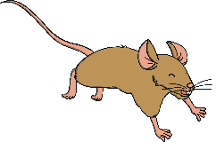
…the mouse ran up the clock.

Slide 4
The clock struck one…

Slide 5
…the mouse ran down.

Slide 6
Hickory Dickory Dock.

